Slide 1
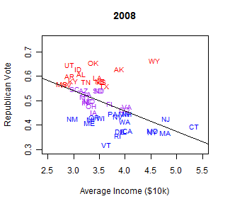
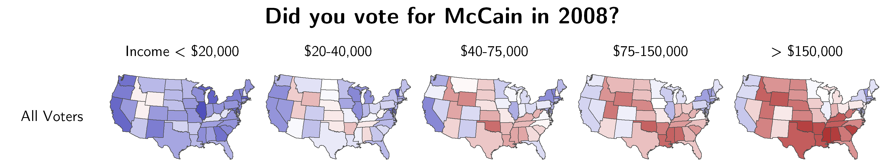

Slide 3
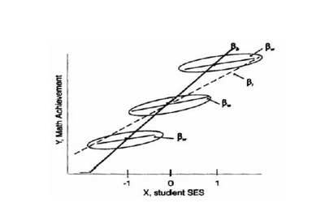

Slide 4
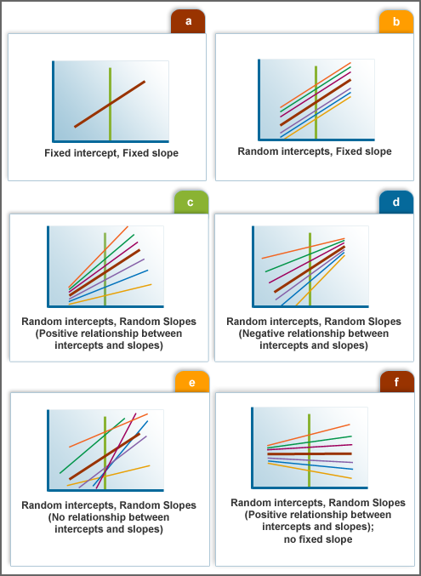

Slide 22
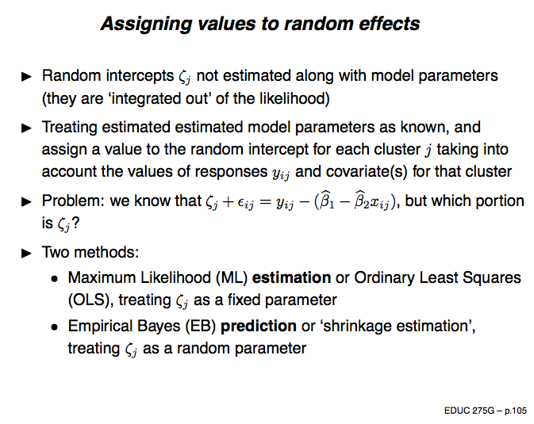

Slide 23
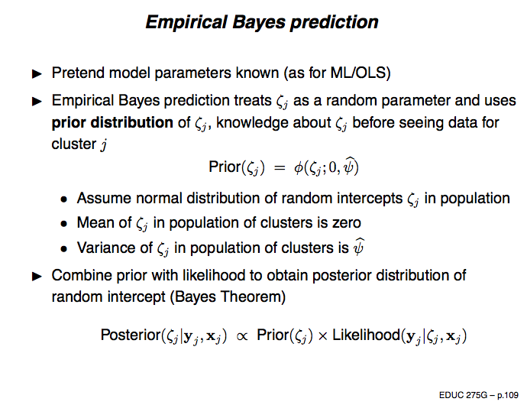

Slide 24
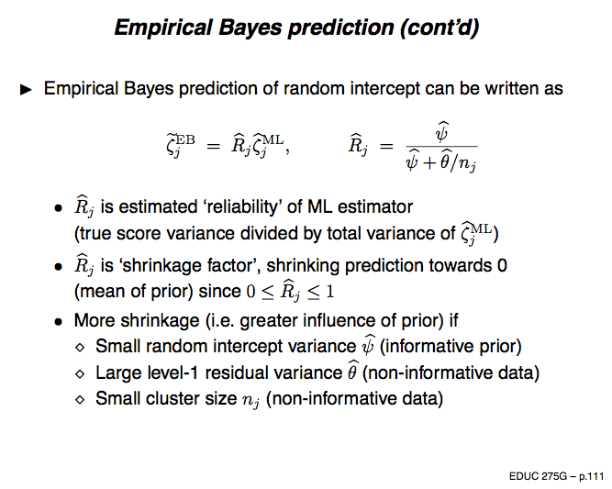

Slide 25
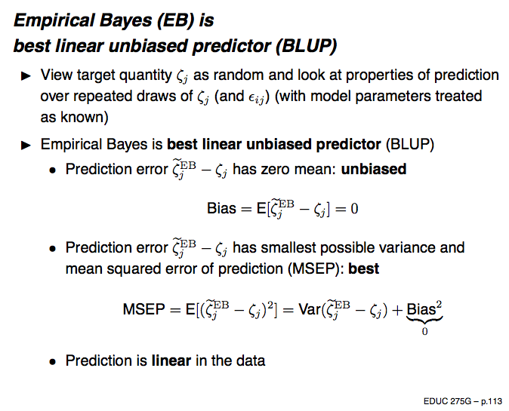
Raudenbush & Bryk (2002): the empirical Bayes estimate is “optimal in that no other
Estimator…has a smaller expected mean-squared error” (p. 47)

Slide 26
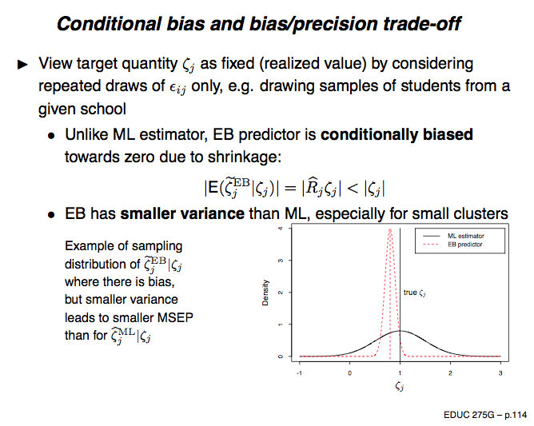
Good article on potential advantages and pitfalls of empirical Bayes estimation:
http://www.mdpi.com/1660-4601/7/2/380/pdf
Zhou, Lee, & Barnes (2010) On application of the empirical Bayes shrinkage in epidemiological settings

